Slide 1
Adversary Tactics and Techniques (Persistence)
Barış Karaer S015497

Slide 2
Persistence
Persistence consists of techniques that adversaries use to keep access to systems across restarts, changed credentials, and other interruptions that could cut off their access. Techniques used for persistence include any access, action, or configuration changes that let them maintain their foothold on systems, such as replacing or hijacking legitimate code or adding startup code.
ID: TA0003
Created: 17 October 2018
Last Modified: 19 July 2019

Slide 3
Persistence Techniques
.bash_profile and .bashrc
Accessibility Features
Account Manipulation
Authentication Package
Create Account
Dylib Hijacking
Valid Accounts
Hooking

Slide 4
Account Manipulation
Account manipulation may aid adversaries in maintaining access to credentials and certain permission levels within an environment. Manipulation could consist of modifying permissions, modifying credentials, adding or changing permission groups, modifying account settings, or modifying how authentication is performed. These actions could also include account activity designed to subvert security policies, such as performing iterative password updates to subvert password duration policies and preserve the life of compromised credentials. In order to create or manipulate accounts, the adversary must already have sufficient permissions on systems or the domain.

Slide 5
Account Manipulation
ID: T1098
Tactic: Credential Access, Persistence
Platform: Windows, Office 365, Azure, GCP, Azure AD, AWS
System Requirements: Exchange email account takeover: Sufficient permission to run the Add-MailboxPermission PowerShell cmdlet (depending on parameters used, may require more permission)
Permissions Required: Administrator
Data Sources: Authentication logs, API monitoring, Windows event logs, Packet capture
Contributors: Jannie Li, Microsoft Threat Intelligence Center (MSTIC); Praetorian; Tim MalcomVetter
Version: 2.0
Created: 31 May 2017
Last Modified: 23 October 2019

Slide 6
Account Manipulation
Exchange Email Account Takeover
The Add-MailboxPermission PowerShell cmdlet, available in on-premises Exchange and in the cloud-based service Office 365, adds permissions to a mailbox. This command can be run, given adequate permissions, to further access granted to certain user accounts. This may be used in persistent threat incidents as well as BEC (Business Email Compromise) incidents where an adversary can assign more access rights to the accounts they wish to compromise. This may further enable use of additional techniques for gaining access to systems. For example, compromised business accounts are often used to send messages to other accounts in the network of the target business while creating inbox rules so the messages evade spam/phishing detection mechanisms.

Slide 7
Account Manipulation Procedure Examples
Name | Description
APT3 | APT3 has been known to add created accounts to local admin groups to maintain elevated access.
Calisto | Calisto adds permissions and remote logins to all users.
Dragonfly 2.0 | Dragonfly 2.0 added newly created accounts to the administrators group to maintain elevated access.
Lazarus Group | Lazarus Group malware WhiskeyDelta-Two contains a function that attempts to rename the administrator’s account.
Magic Hound | Magic Hound granted compromised email accounts read access to the email boxes of additional targeted accounts. The group then was able to authenticate to the intended victim's OWA (Outlook Web Access) portal and read hundreds of email communications for information on Middle East organizations.
Mimikatz | The Mimi Katz credential dumper has been extended to include Skeleton Key domain controller authentication bypass functionality. The LSADUMP::ChangeNTLM and LSADUMP::SetNTLM modules can also manipulate the password hash of an account without knowing the clear text value.
Skeleton Key | Skeleton Key is used to patch an enterprise domain controller authentication process with a backdoor password. It allows adversaries to bypass the standard authentication system to use a defined password for all accounts authenticating to that domain controller.

Slide 8
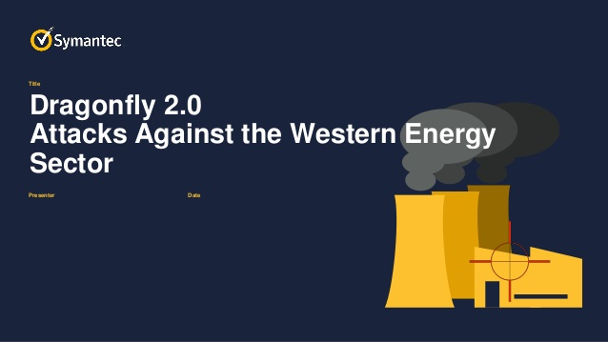
Dragonfly 2.0
Dragonfly 2.0 is a suspected Russian group that has targeted government entities and multiple U.S. critical infrastructure sectors since at least March 2016.
Some techniques that are used are account manipulation, spear fishing, brute force, create account and file deletion.

Slide 9
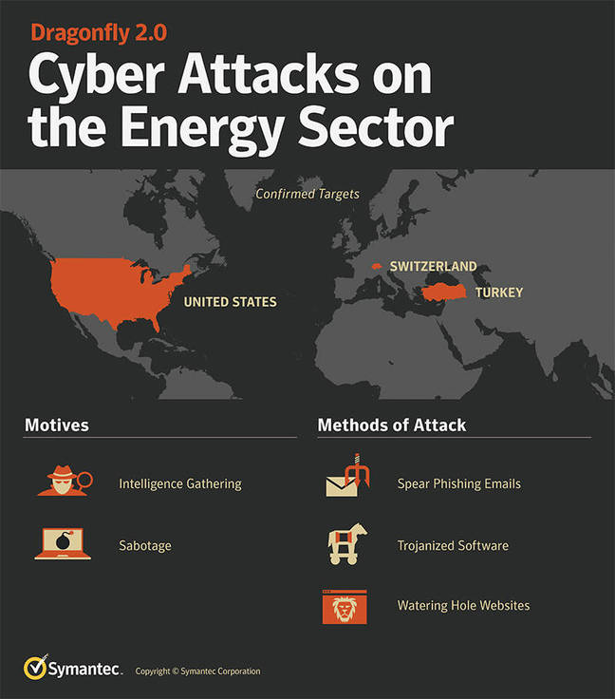
Dragonfly 2.0

Slide 10
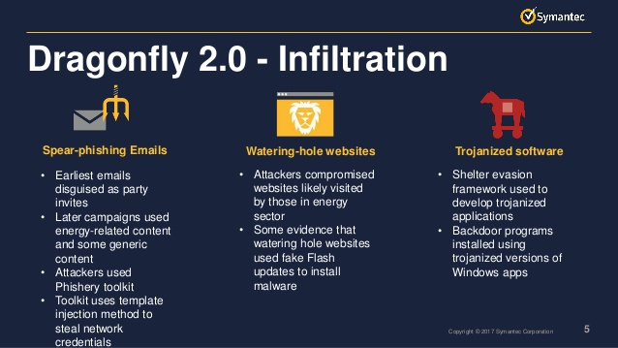

Slide 11

APT3
APT3 is a China-based D threat group that researchers have attributed to China's Ministry of State Security. This group is responsible for the campaigns known as Operation Clandestine Fox, Operation Clandestine Wolf, and Operation ouble Tap. As of June 2015, the group appears to have shifted from targeting primarily US victims to primarily political organizations in Hong Kong.

Slide 12
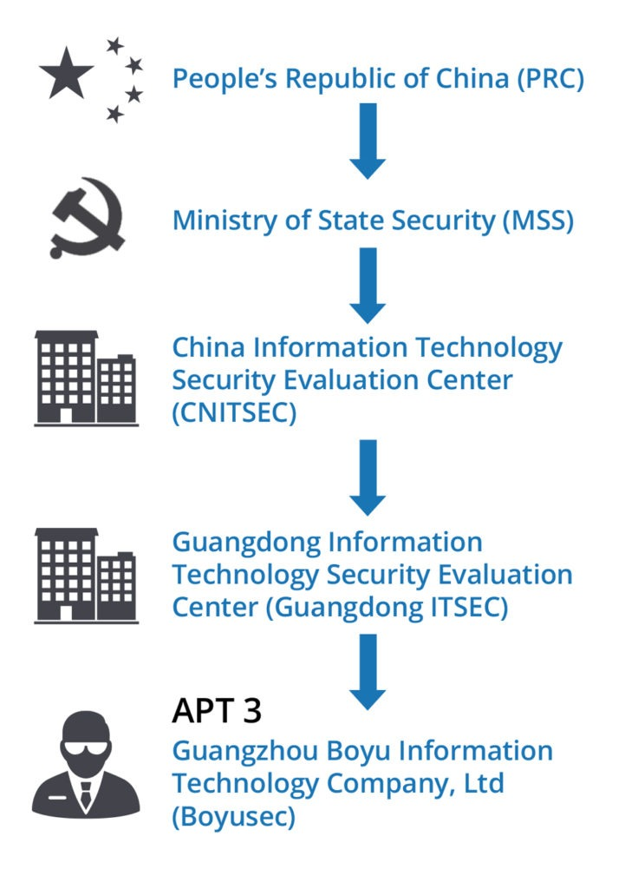

Slide 13
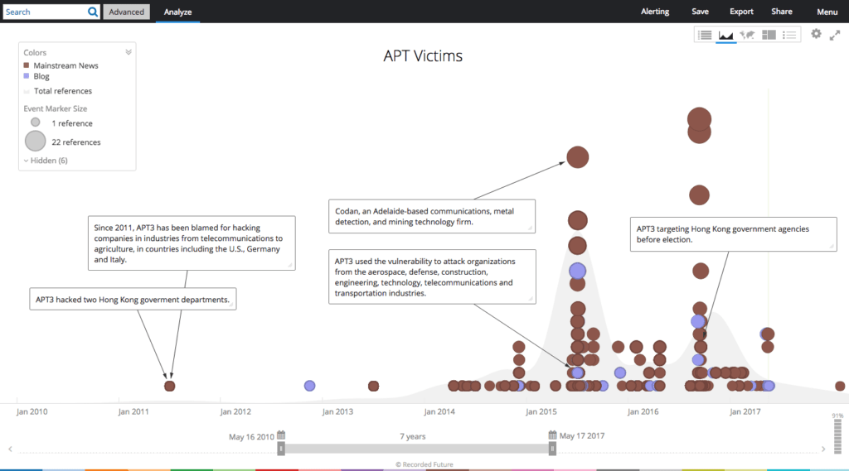

Slide 14
Account Manipulation Mitigation Examples
Mitigation | Description
Multi-factor Authentication | Use multi-factor authentication for user and privileged accounts.
Network Segmentation | Configure access controls and firewalls to limit access to critical systems and domain controllers. Most cloud environments support separate virtual private cloud (VPC) instances that enable further segmentation of cloud systems.
Operating System Configuration | Protect domain controllers by ensuring proper security configuration for critical servers to limit access by potentially unnecessary protocols and services, such as SMB file sharing.
Privileged Account Management | Do not allow domain administrator accounts to be used for day-to-day operations that may expose them to potential adversaries on unprivileged systems.

Slide 15
Account Manipulation Detection
Collect events that correlate with changes to account objects on systems and the domain, such as event ID 4738. Monitor for modification of accounts in correlation with other suspicious activity. Changes may occur at unusual times or from unusual systems. Especially flag events where the subject and target accounts differ or that include additional flags such as changing a password without knowledge of the old password.
Use of credentials may also occur at unusual times or to unusual systems or services and may correlate with other suspicious activity.
Monitor for unusual Exchange and Office 365 email account permissions changes that may indicate excessively broad permissions being granted to compromised accounts.
A larger volume of emails sent from an account than normal and the discovery of similar phishing emails being sent from real accounts within a network may be signs that an account may have been compromised and attempts to leverage access with modified email permissions is occurring.

Slide 16
Create Account
Adversaries with a sufficient level of access may create that do not require persistent remote access local system, domain, or cloud tenant account. Such accounts may be used for persistence ss tools to be deployed on the system.
In cloud environments, adversaries may create accounts that only have access to specific services, which can reduce the chance of detection.

Slide 17
Create Account Procedure Examples
Name | Description
APT3 | APT3 has been known to create or enable accounts, such as support_388945a0.
APT41 | APT41 created user accounts and adds them to the User and Admin groups.
Calisto | Calisto has the capability to add its own account to the victim's machine.
Carbanak | Carbanak can create a Windows account.
Dragonfly 2.0 | Dragonfly 2.0 created accounts on victims, including administrator accounts, some of which appeared to be tailored to each individual staging target.
Empire | Empire has a module for creating a new domain user or local user if permissions allow.
Flame | Flame can create backdoor accounts with the login "HelpAssistant" with the Limbo module.
HiddenWasp | Hidden Wasp creates a user account as a means to provide initial persistence to the compromised machine.

Slide 18
Create Account Mitigations
Mitigation | Description
Multi-factor Authentication | Use multi-factor authentication for user and privileged accounts.
Network Segmentation | Configure access controls and firewalls to limit access to domain controllers and systems used to create and manage accounts.
Operating System Configuration | Protect domain controllers by ensuring proper security configuration for critical servers.
Privileged Account Management | Do not allow domain administrator accounts to be used for day-to-day operations that may expose them to potential adversaries on unprivileged systems.

Slide 19
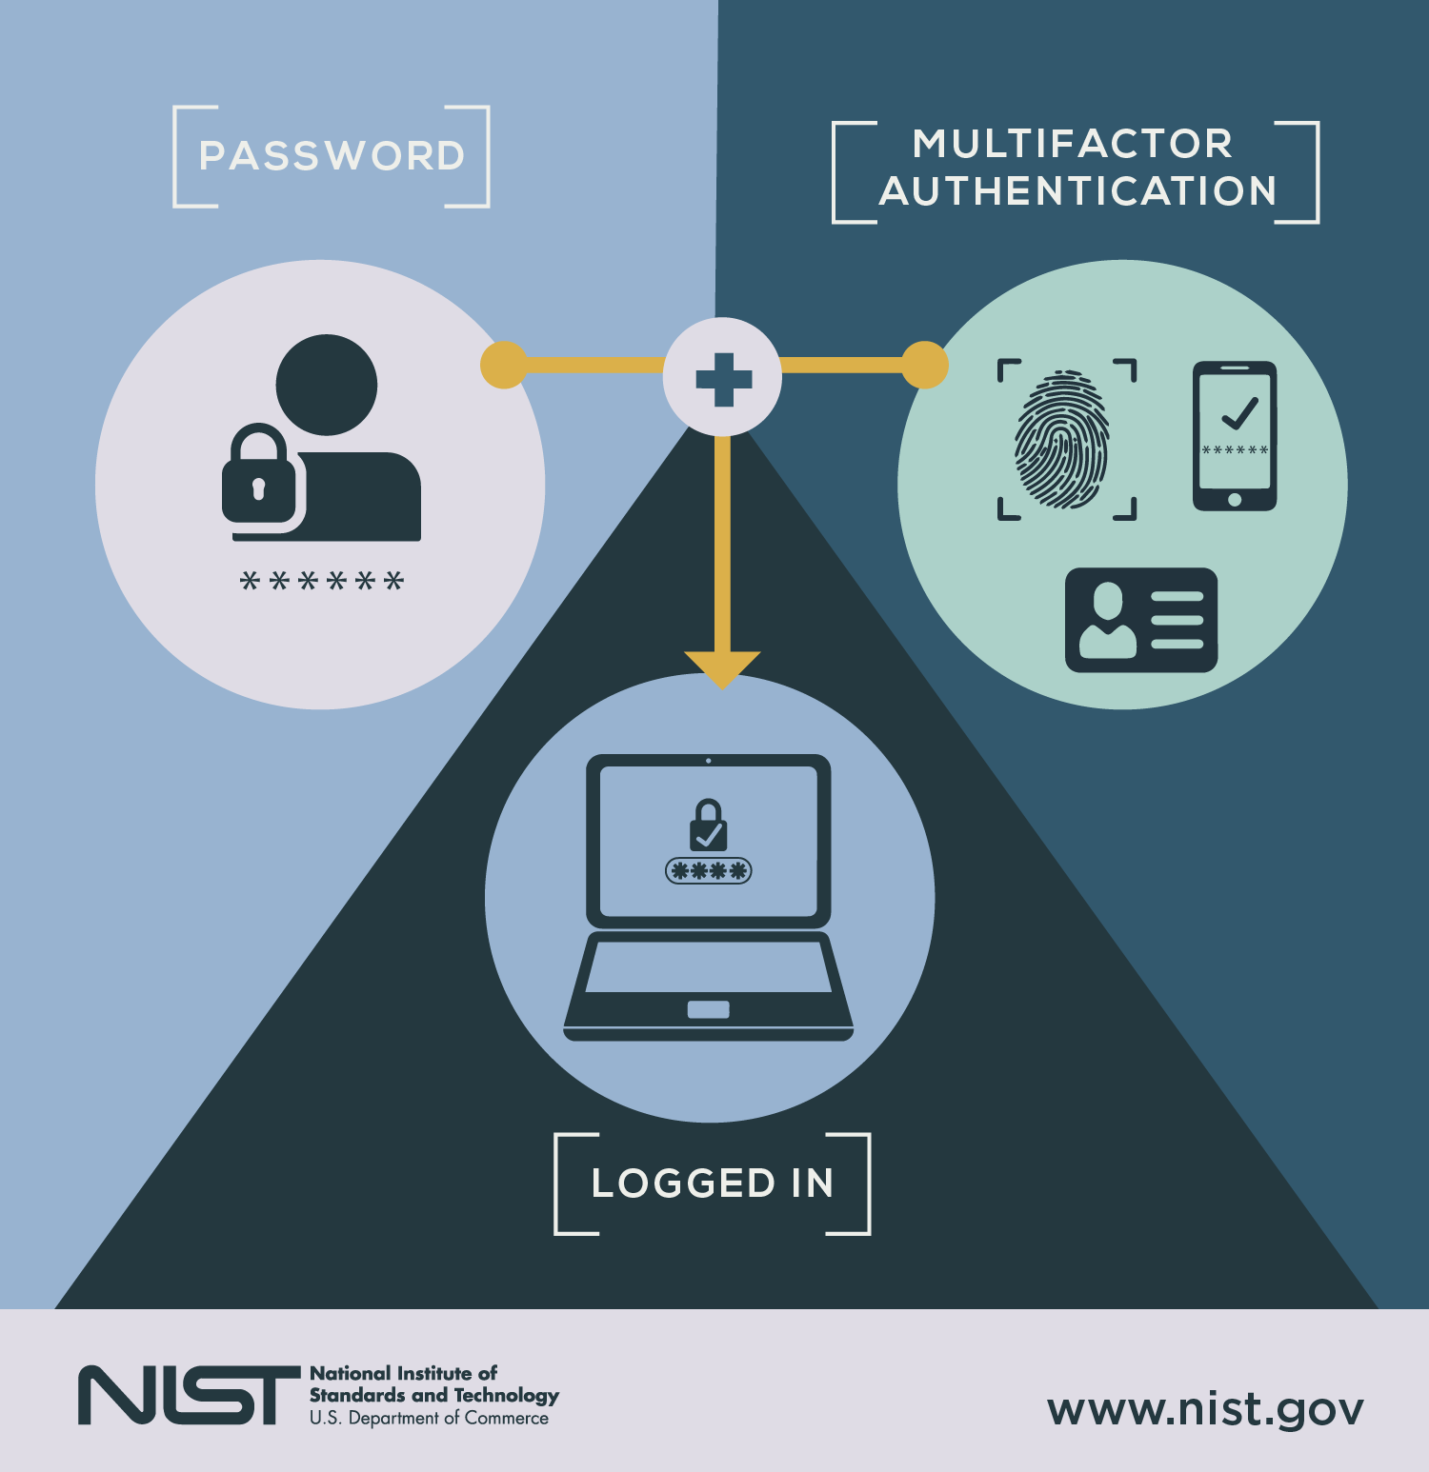
Multi Factor Authentication
Multi-factor authentication is an authentication method in which a computer user is granted access only after successfully presenting two or more pieces of evidence (or factors) to an authentication mechanism

Slide 20
Create Account Detection
Collect data on account creation within a network. Event ID 4720 is generated when a user account is created on a Windows system and domain controller. Perform regular audits of domain and local system accounts to detect suspicious accounts that may have been created by an adversary.
Collect usage logs from cloud administrator accounts to identify unusual activity in the creation of new accounts and assignment of roles to those accounts. Monitor for accounts assigned to admin roles that go over a certain threshold of known admins.

Slide 21
Valid Accounts
Adversaries may steal the credentials of a specific user or service account using Credential Access techniques or capture credentials earlier in their reconnaissance process through social engineering for means of gaining Initial Access.
Accounts that an adversary may use can fall into three categories: default, local, and domain accounts. Default accounts are those that are built-into an OS such as Guest or Administrator account on Windows systems or default factory/provider set accounts on other types of systems, software, or devices. Local accounts are those configured by an organization for use by users, remote support, services, or for administration on a single system or service. Domain accounts are those managed by Active Directory Domain Services where access and permissions are configured across systems and services that are part of that domain. Domain accounts can cover users, administrators, and services.

Slide 22
Valid Accounts
Compromised credentials may be used to bypass access controls placed on various resources on systems within the network and may even be used for persistent access to remote systems and externally available services, such as VPNs, Outlook Web Access and remote desktop. Compromised credentials may also grant an adversary increased privilege to specific systems or access to restricted areas of the network. Adversaries may choose not to use malware or tools in conjunction with the legitimate access those credentials provide to make it harder to detect their presence.
Default accounts are also not limited to Guest and Administrator on client machines, they also include accounts that are preset for equipment such as network devices and computer applications whether they are internal, open source, or COTS. Appliances that come preset with a username and password combination pose a serious threat to organizations that do not change it post installation, as they are easy targets for an adversary. Similarly, adversaries may also utilize publicly disclosed private keys, or stolen private keys, to legitimately connect to remote environments via Remote Services

Slide 23
Valid Accounts
The overlap of account access, credentials, and permissions across a network of systems is of concern because the adversary may be able to pivot across accounts and systems to reach a high level of access (i.e., domain or enterprise administrator) to bypass access controls set within the enterprise.

Slide 24
Valid Accounts Procedure Examples
Name | Description
APT18 | APT18 actors leverage legitimate credentials to log into external remote services.
APT28 | APT28 has used legitimate credentials to gain initial access, maintain access, and exfiltrate data from a victim network. The group has specifically used credentials stolen through a spear phishing email to login to the DCCC network. The group has also leveraged default manufacturer's passwords to gain initial access to corporate networks via IoT devices such as a VOIP phone, printer, and video decoder.
APT3 | APT3 leverages valid accounts after gaining credentials for use within the victim domain.
APT32 | APT32 has used legitimate local admin account credentials.
APT33 | APT33 has used valid accounts for initial access and privilege escalation.
APT39 | APT39 has used stolen credentials to compromise Outlook Web Access (OWA).
APT41 | APT41 used compromised credentials to log on to other systems.
Carbanak | Carbanak actors used legitimate credentials of banking employees to perform operations that sent them millions of dollars.
Cobalt Strike | Cobalt Strike can use known credentials to run commands and spawn processes as another user.

Slide 25
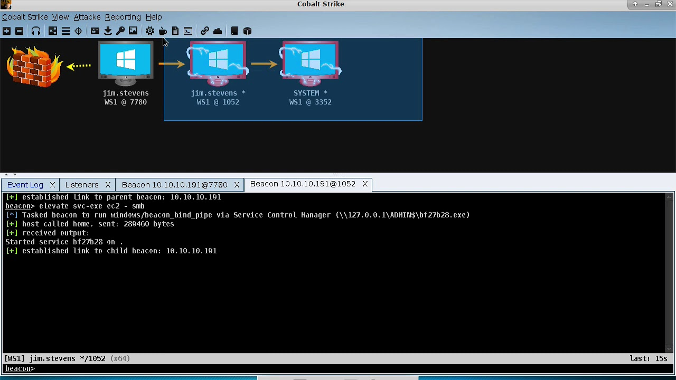
Cobalt Strike
Cobalt Strike is a paid penetration testing product that allows an attacker to deploy an agent named 'Beacon' on the victim machine. Beacon includes a wealth of functionality to the attacker, including, but not limited to command execution, key logging, file transfer, SOCKS proxying, privilege escalation, mimikatz, port scanning and lateral movement.

Slide 26
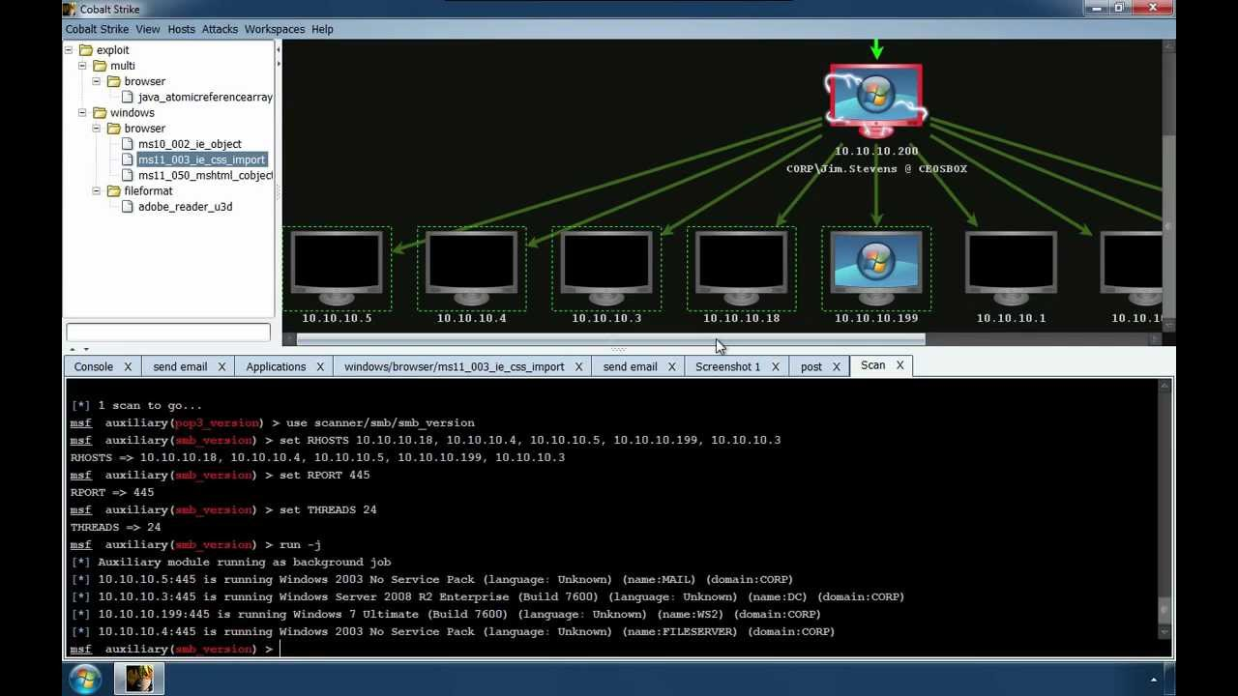
Cobalt Strike
The Beacon implant has become popular amongst targeted attackers and criminal users as it is well written, stable and highly customizable. Even if some tools like this are created only for scientific purposes, some criminals can use it for many criminal activities.

Slide 27
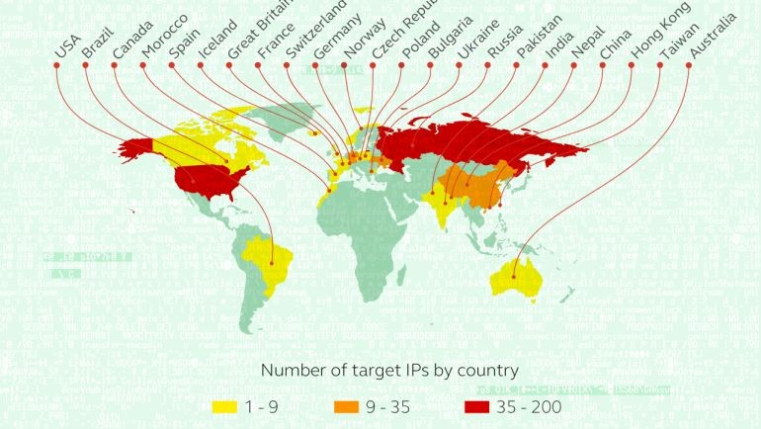
Carbanak
Carbanak is an APT-style campaign targeting (but not limited to) financial institutions that was claimed to have been discovered in 2014 by the Russian/UK Cyber Crime company Kaspersky Lab who said that it had been used to steal money from banks. The Microsoft Windows malware was said to have been introduced to its targets via phishing emails. The hacker group was said to have stolen over 900 million dollars, not only from the banks but from more than a thousand private customers.

Slide 28
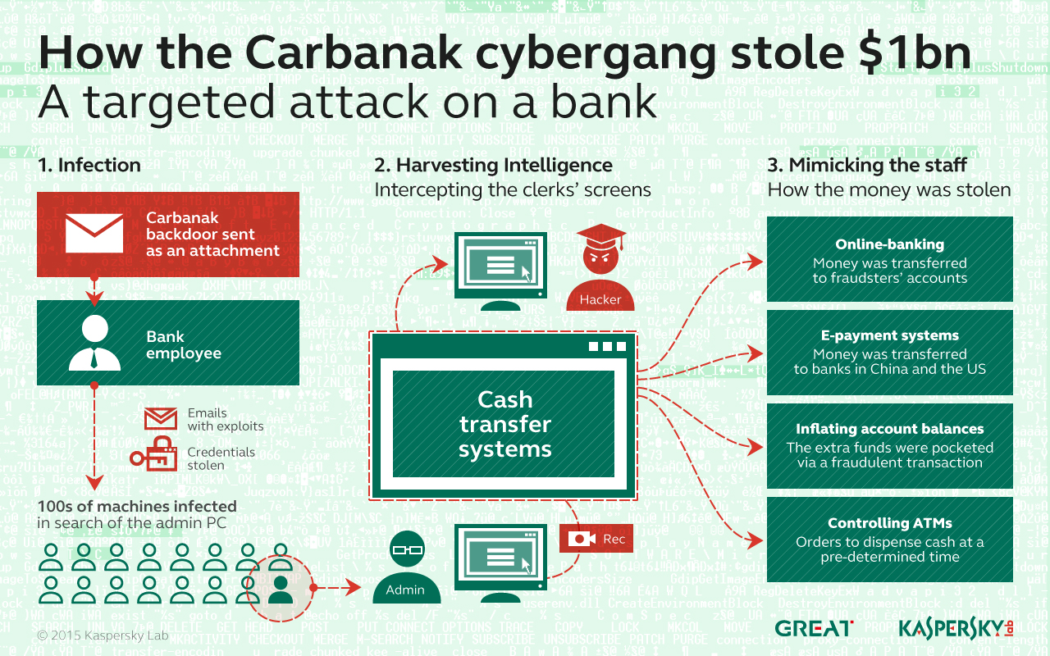

Slide 29
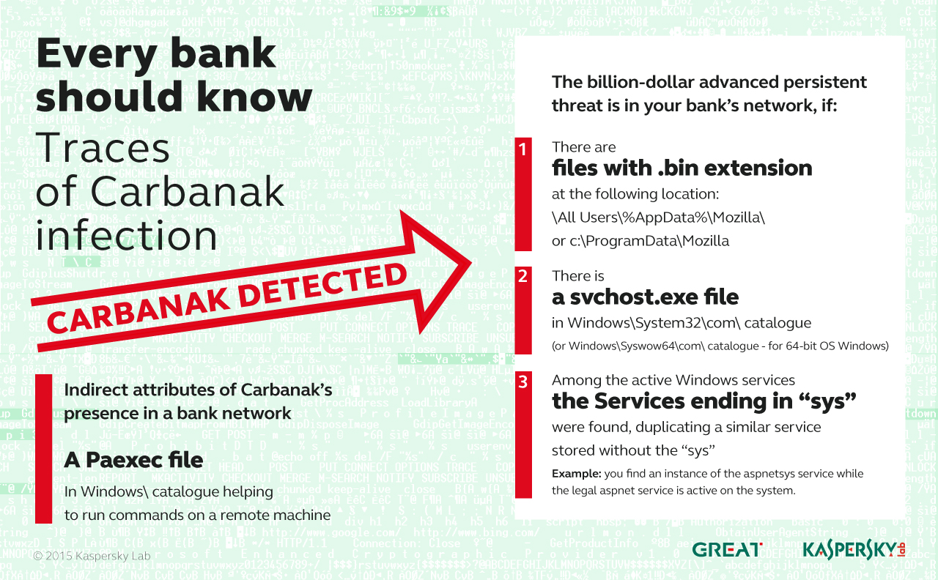

Slide 30
Valid Accounts Mitigations
Mitigation | Description
Application Developer Guidance | Ensure that applications do not store sensitive data or credentials insecurely. (e.g. plaintext credentials in code, published credentials in repositories, or credentials in public cloud storage).
Audit | Routinely audit source code, application configuration files, open repositories, and public cloud storage for insecure use and storage of credentials.
Filter Network Traffic | Cloud service providers support IP-based restrictions when accessing cloud resources. Consider using IP whitelisting on cloud-based systems along with user account management to ensure that data access is restricted not only to valid users but only from expected IP ranges to mitigate the use of stolen credentials to access data.
Multi-factor Authentication | Integrating multi-factor authentication (MFA) as part of organizational policy can greatly reduce the risk of an adversary gaining control of valid credentials that may be used for additional tactics such as initial access, lateral movement, and collecting information. MFA can also be used to restrict access to cloud resources and APIs.
Password Policies | Applications and appliances that utilize default username and password should be changed immediately after the installation, and before deployment to a production environment. When possible, applications that use SSH keys should be updated periodically and properly secured. Ensure that local administrator accounts have complex, unique passwords across all systems on the network. In cloud environments, consider rotating access keys within a certain number of days for reducing the effectiveness of stolen credentials.

Slide 31
Valid Accounts Detection
Configure robust, consistent account activity audit policies across the enterprise and with externally accessible services. Look for suspicious account behavior across systems that share accounts, either user, admin, or service accounts. Examples: one account logged into multiple systems simultaneously; multiple accounts logged into the same machine simultaneously; accounts logged in at odd times or outside of business hours. Activity may be from interactive login sessions or process ownership from accounts being used to execute binaries on a remote system as a particular account. Correlate other security systems with login information (e.g., a user has an active login session but has not entered the building or does not have VPN access).
Perform regular audits of domain and local system accounts to detect accounts that may have been created by an adversary for persistence. Checks on these accounts could also include whether default accounts such as Guest have been activated. These audits should also include checks on any appliances and applications for default credentials or SSH keys, and if any are discovered, they should be updated immediately.

Slide 32
Sources
https://www.recordedfuture.com/chinese-mss-behind-apt3/
https://attack.mitre.org/
Wikipedia
https://malpedia.caad.fkie.fraunhofer.de/

Slide 33
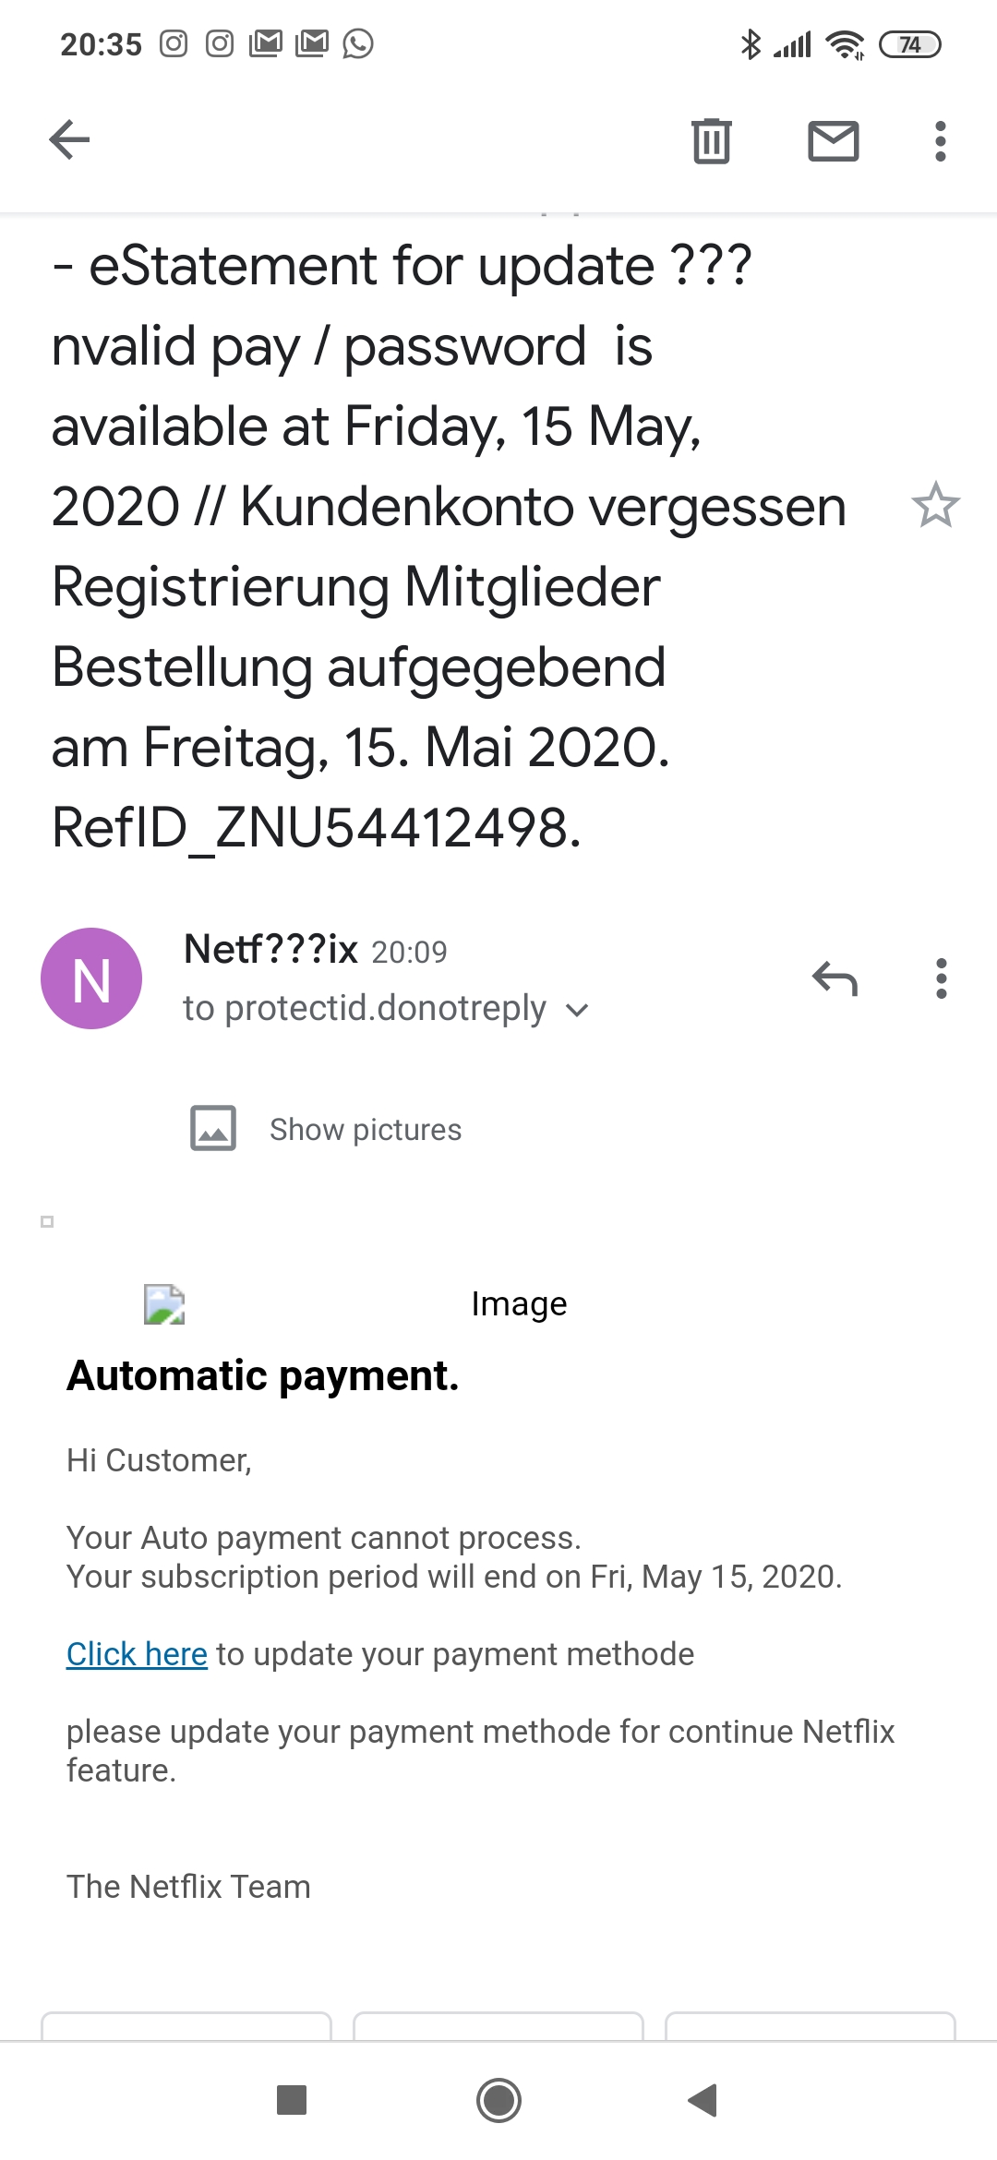

Slide 34
Thank you for listening !

